Slide 1
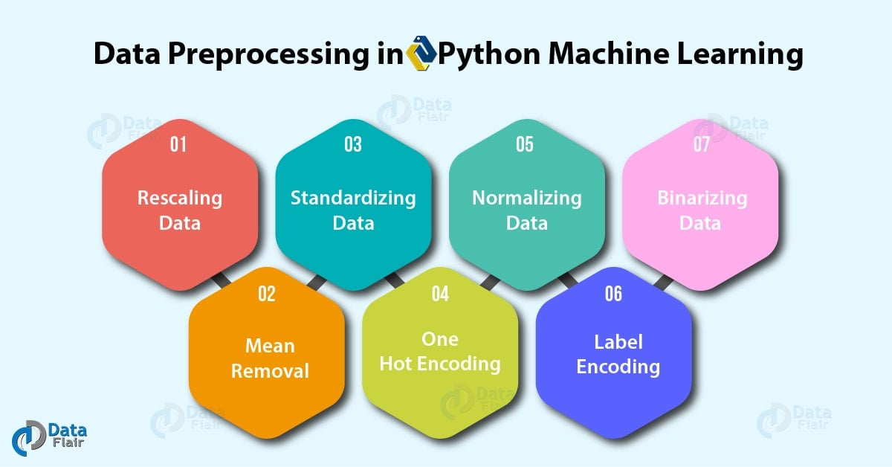
INFOSYS SPRINGBOARD INTERNSHIP 6.0
Data Preprocessing for
Facebook Food Trends Analysis
Group: 3
Building Quality Data for Insightful Analytics
For Milestone: 1
Data Preprocessing Team
Visualization Team
Subrat & Himaja
Magesh & Sravanthi

Slide 2
Project Foundation
Problem Statement & Objective
Problem Statement
Project Objective
Food brands on Facebook generate massive engagement data that remains underutilized due to data quality issues and lack of proper preprocessing.
Transform raw Facebook food trends data into a clean, analysis-ready dataset for Power BI visualization and trend analysis.
Raw social media data contains inconsistencies and missing values
Enable accurate trend and sentiment analysis
Engagement metrics require standardization for accurate analysis
Support Power BI dashboard creation
Ensure data quality for reliable insights
Time-based patterns need validation for trend identification

Slide 3
Data Source
Dataset Description
Parameter Categories
Facebook Food Trends Dataset
Post Details
foodtrends_facebook_cleaned.xlsx
1
Content identifiers, post types, and textual information
A comprehensive collection of food brand posts from Facebook designed to analyze engagement patterns, consumer sentiment, and trending content in the food industry.
2
Engagement Metrics
Likes, comments, shares, and overall interaction counts
3
Reaction Metrics
Dataset Size
Data Source
Love, wow, haha, sad, angry reactions distribution
Total Records
1,000
Custom dataset compiled from Facebook food brand posts , capturing authentic engagement metrics and content characteristics.
16
4
Time-Based Features
Features
Post timing, seasonal patterns, and temporal trends

Slide 4
Data Structure
Dataset Parameters
Post Details
Engagement Metrics
Post ID - Unique identifier
Likes - Total like count
Post Title - Content headline
Comments - Comment volume
Post Content - Text body
Shares - Share frequency
Post Type - Image, video, link
Total Engagement - Aggregated score
Reaction Metrics
Time-Based Features
Love
Wow
Post Date - Publication date
Haha
Sad
Post Time - Hour and minute
Angry
Sentiment
Day of Week - Weekday patterns
Season/Month - Seasonal trends

Slide 5
Approach
Preprocessing Methodology
Workflow Overview
Tools Used
A systematic five-stage approach to transform raw data into analysis-ready format, ensuring quality and consistency throughout the process.
Python
Primary programming language for data manipulation and automation
1
2
3
4
5
Data Loading
Cleaning
Validation
Transformation
Export
Pandas
Library for data structures and analysis operations
Key Principles
Data Integrity
Quality Assurance
Excel
Initial data review and final output format
Consistency
Efficiency

Slide 6
Implementation
Key Preprocessing Steps
1
Missing Value Handling
2
Data Type Standardization
3
Duplicate Checking
Identified and addressed incomplete data entries to ensure dataset completeness.
Ensured consistent data formats for accurate analysis and processing.
Eliminated redundant records to maintain data integrity and accuracy.
Null value detection across all features
Strategic imputation based on data type
Numeric fields converted to proper types
Cross-field duplicate identification
Removal of records with excessive missing data
Date-time formats unified
Retention of most complete records
Categorical variables properly encoded
Verification of removal accuracy
4
Engagement Recalculation
5
Sentiment & Time Validation
Validated and recalculated engagement metrics for consistency.
Ensured accuracy of sentiment labels and temporal data for reliable trend analysis.
Sum verification of reaction counts
Total engagement score computation
Sentiment score range validation
Date consistency checks
Outlier detection and treatment
Logical consistency of reactions
Time sequence verification

Slide 7
Outcome
Final Dataset Readiness
Clean & Validated Dataset
Ready for Power BI
The preprocessing pipeline has successfully transformed the raw data into a high-quality, analysis-ready dataset that meets all requirements for Power BI visualization.
Trend Analysis
Temporal patterns and seasonal trends
100%
Zero
16
Complete Records
Duplicates
Validated Features
Sentiment Analysis
Quality Assurance Measures
Reaction distribution and sentiment scores
Cross-field validation completed
Data type consistency verified
Engagement metrics recalculated
Temporal data validated
Engagement Insights
Performance metrics and engagement patterns
Sentiment scores verified
Outlier treatment applied

Slide 8
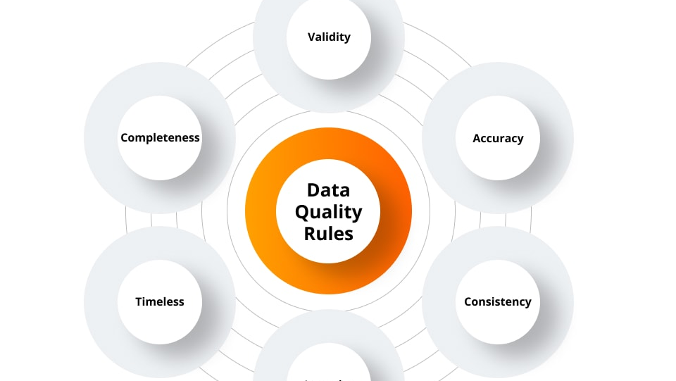
Conclusion
Importance of Preprocessing
Data preprocessing is the foundation of reliable analytics. Without proper cleaning and validation, insights derived from raw data can be misleading and inaccurate.
Ensures Data Quality: Clean data leads to trustworthy analysis results
Enables Accurate Insights: Preprocessed data reveals true patterns and trends
Supports Decision Making: Reliable data drives informed business strategies
Facilitates Visualization: Clean data enables effective dashboard creation
"Quality data is the foundation of quality insights"

